Slide 1
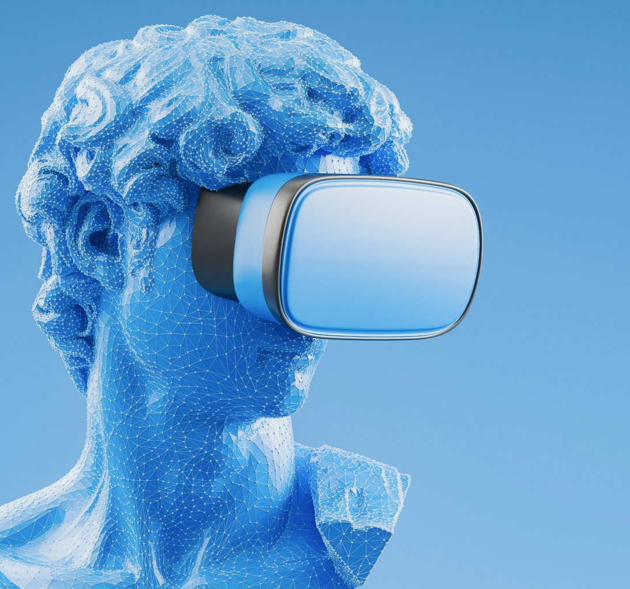

29th May 2025
Virtual Reality Project Proposal:
Review of TVMC: Time-Varying Mesh Compression Using Volume Tracked Reference by Guodong Chen, Filip Hácha, Libor Váša, Mallesham Dasari
Andrew Xie, Srotriyo Sengupta, Satrajit Ghosh
VR
Technology: 16:332:571
Electrical and Computer Engineering

Slide 2
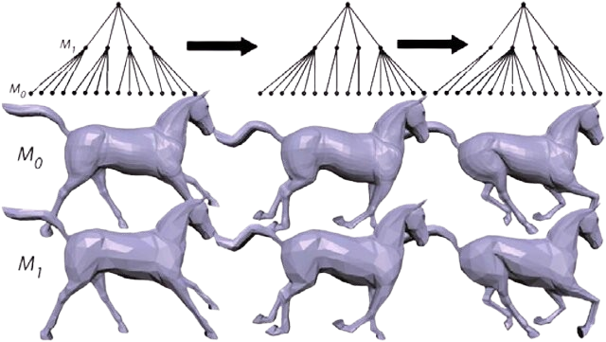
The Problem:
Time-Varying Mesh Compression
Time-Varying Meshes (TVMs) are sequences of dynamic 3D meshes used in AR/VR, telepresence, and volumetric video.
Each frame may have a different number of vertices, connectivity, and overall topology.
TVMs often include complex non-rigid motion and self-contact (e.g., touching limbs, crossed arms).
This dynamic variability makes compression difficult for traditional methods.
Existing codecs like MPEG V-DMC require consistent mesh topology, which real-world scans often lack.
Frame-based compressors like Google Draco treat each mesh independently, missing temporal redundancy.
Standard methods fail to preserve geometry in self-contact regions, leading to artifacts like sticking fingers or distorted joints.
Prior techniques using non-rigid ICP or embedded deformation rely only on surface point correspondences.
These methods accumulate error over time and struggle in occlusion-heavy or high-deformation regions.

Slide 3
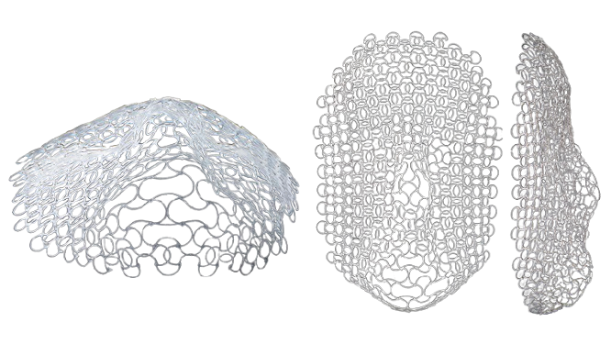
Significance of the Problem
Time-Varying Meshes (TVMs) are crucial for applications like AR/VR, digital humans, telepresence, and 3D video streaming — but their large size and dynamic topology make them hard to store and transmit efficiently.
Current compression methods (e.g., Google Draco, V-DMC) often treat each frame independently or rely on weak temporal correlations, leading to suboptimal compression and high decoding times.
TVMC (Chen et al., MMSys 2025) introduces a novel compression strategy using volume tracking and reference mesh extraction, claiming lower bitrates (4–6 Mbps) and reduced decoding time (by 66.1%).
These advancements could enable real-time, bandwidth-efficient 3D mesh streaming, unlocking smoother XR experiences on limited hardware or networks. Therefore, it is vital to review and validate the claims in the TVMC paper, as well as to identify any limitations or areas of improvement that could further advance compression techniques and the broader field of dynamic mesh processing.

Slide 4
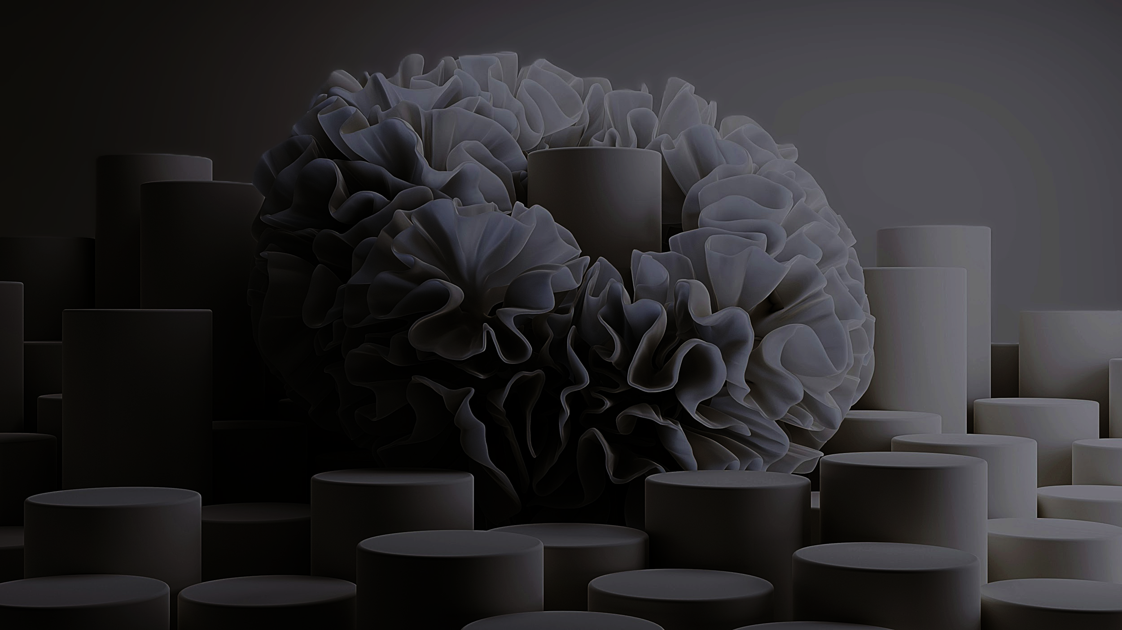
Solutions Evaluated

Slide 5
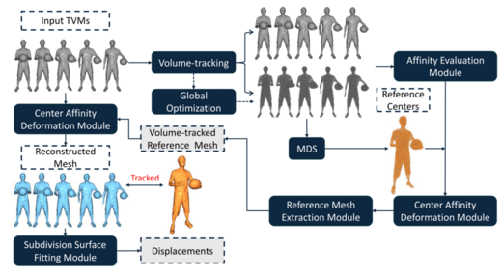
TVMC (Chen et al., MMSys 2025) introduces a new pipeline for compressing Time-Varying Meshes (TVMs) — which are notoriously difficult due to changing topology, self-contact, and lack of vertex correspondence.
ARAP Volume Tracking Generates volumetric center trajectories across frames using As-Rigid-As-Possible (ARAP) deformation. This provides stable "internal handles" even with changing mesh surface topology.
Reference Center Generation (MDS) Uses Multidimensional Scaling (MDS) to project center trajectories into a canonical "reference space," ensuring that regions with self-contact are separated.
Self-Contact Filtering Quantifies self-contact via a novel center affinity metric. Frames with high self-contact degree are dropped from reference mesh fusion to avoid distortion.
Reference Mesh Extraction Deforms low-contact frames into reference space. Uses subdivision surface fitting + Poisson reconstruction to produce a clean, self-contact-free reference mesh.
Figure: Pipeline overview adapted from TVMC: Time-Varying Mesh Compression Using Volume-Tracked Reference Meshes by Chen et al.

Slide 6
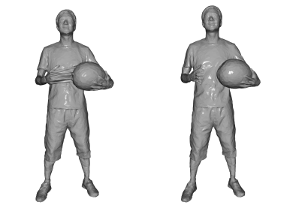
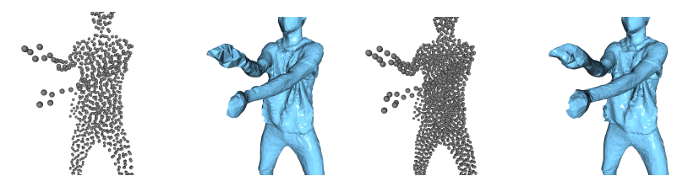
From Deformation to Displacement
5. Center Affinity Deformation (CAD) Meshes are reconstructed from the reference mesh using dual quaternion transformations based on the motion of volume centers. Unlike traditional embedded deformation, CAD is topology-aware and uses affinity-weighted blending, which helps preserve structure even in complex, self-contact regions.
6. Displacement Compression The difference between each original frame and its corresponding deformed reference mesh is encoded as a displacement field. Displacements are treated as point clouds and compressed using Google Draco. The reference mesh is separately compressed with Draco using high-quality settings.
Claimed Advantages
Achieves 4–6 Mbps bitrate, outperforming:
Google Draco (9–12 Mbps)
V-DMC (10–15 Mbps)
Offers 66.1% faster decoding times
Can compress GoF = 15 meshes together (compared to 5 in prior methods)
Maintains better visual quality in challenging regions involving self-contact (e.g., hands, arms)
Comparison of deformation results for frames with and without self-contact. Left: deformation failure due to fingers and basketball being in contact. Right: clean deformation when objects are separated. TVMC handles such self-contact regions by filtering frames with high distortion potential before reference mesh extraction. Source: Figure 1 from TVMC: Time-Varying Mesh Compression Using Volume-Tracked Reference Meshes, Chen et al., MMSys 2025.
Subjective evaluation of volume center density in TVMC. (a, b) show the center visualization and reconstruction result for 1000 centers, while (c, d) show the same for 2000 centers. Increasing the number of centers improves reconstruction quality, especially in high-detail regions like arms and hands. Source: Adapted from Figure 6 (top row) of TVMC: Time-Varying Mesh Compression Using Volume-Tracked Reference Meshes, Chen et al., MMSys 2025.

Slide 7
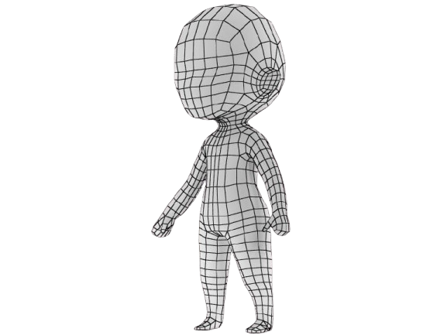
Reproducibility Test — Our Implementation and Evaluation
Objective:
Validate the reproducibility of the TVMC pipeline by running the authors' released code and evaluating its performance on both the provided and additional datasets.
What We Did:
Ran the official TVMC pipeline end-to-end, including:
ARAP volume center tracking
Reference center generation via MDS
Self-contact filtering and mesh deformation
Subdivision surface fitting + Poisson reconstruction
Displacement extraction and compression
Verified output quality and compression performance on:
The original dataset provided by the authors
Two additional datasets:
50004_female_chicken_wings (DFAUAST Secuence, high motion)
50004_shake_arms (DFAUST sequence with occlusion and self-contact)
Additional Baseline Comparison:
Applied Google Draco compression independently to each mesh in both test sequences.
Compared TVMC + Draco vs. Draco-only in terms of:
Bitrate
Decoding time
Visual fidelity under motion and self-contact

Slide 8

Results

Slide 9
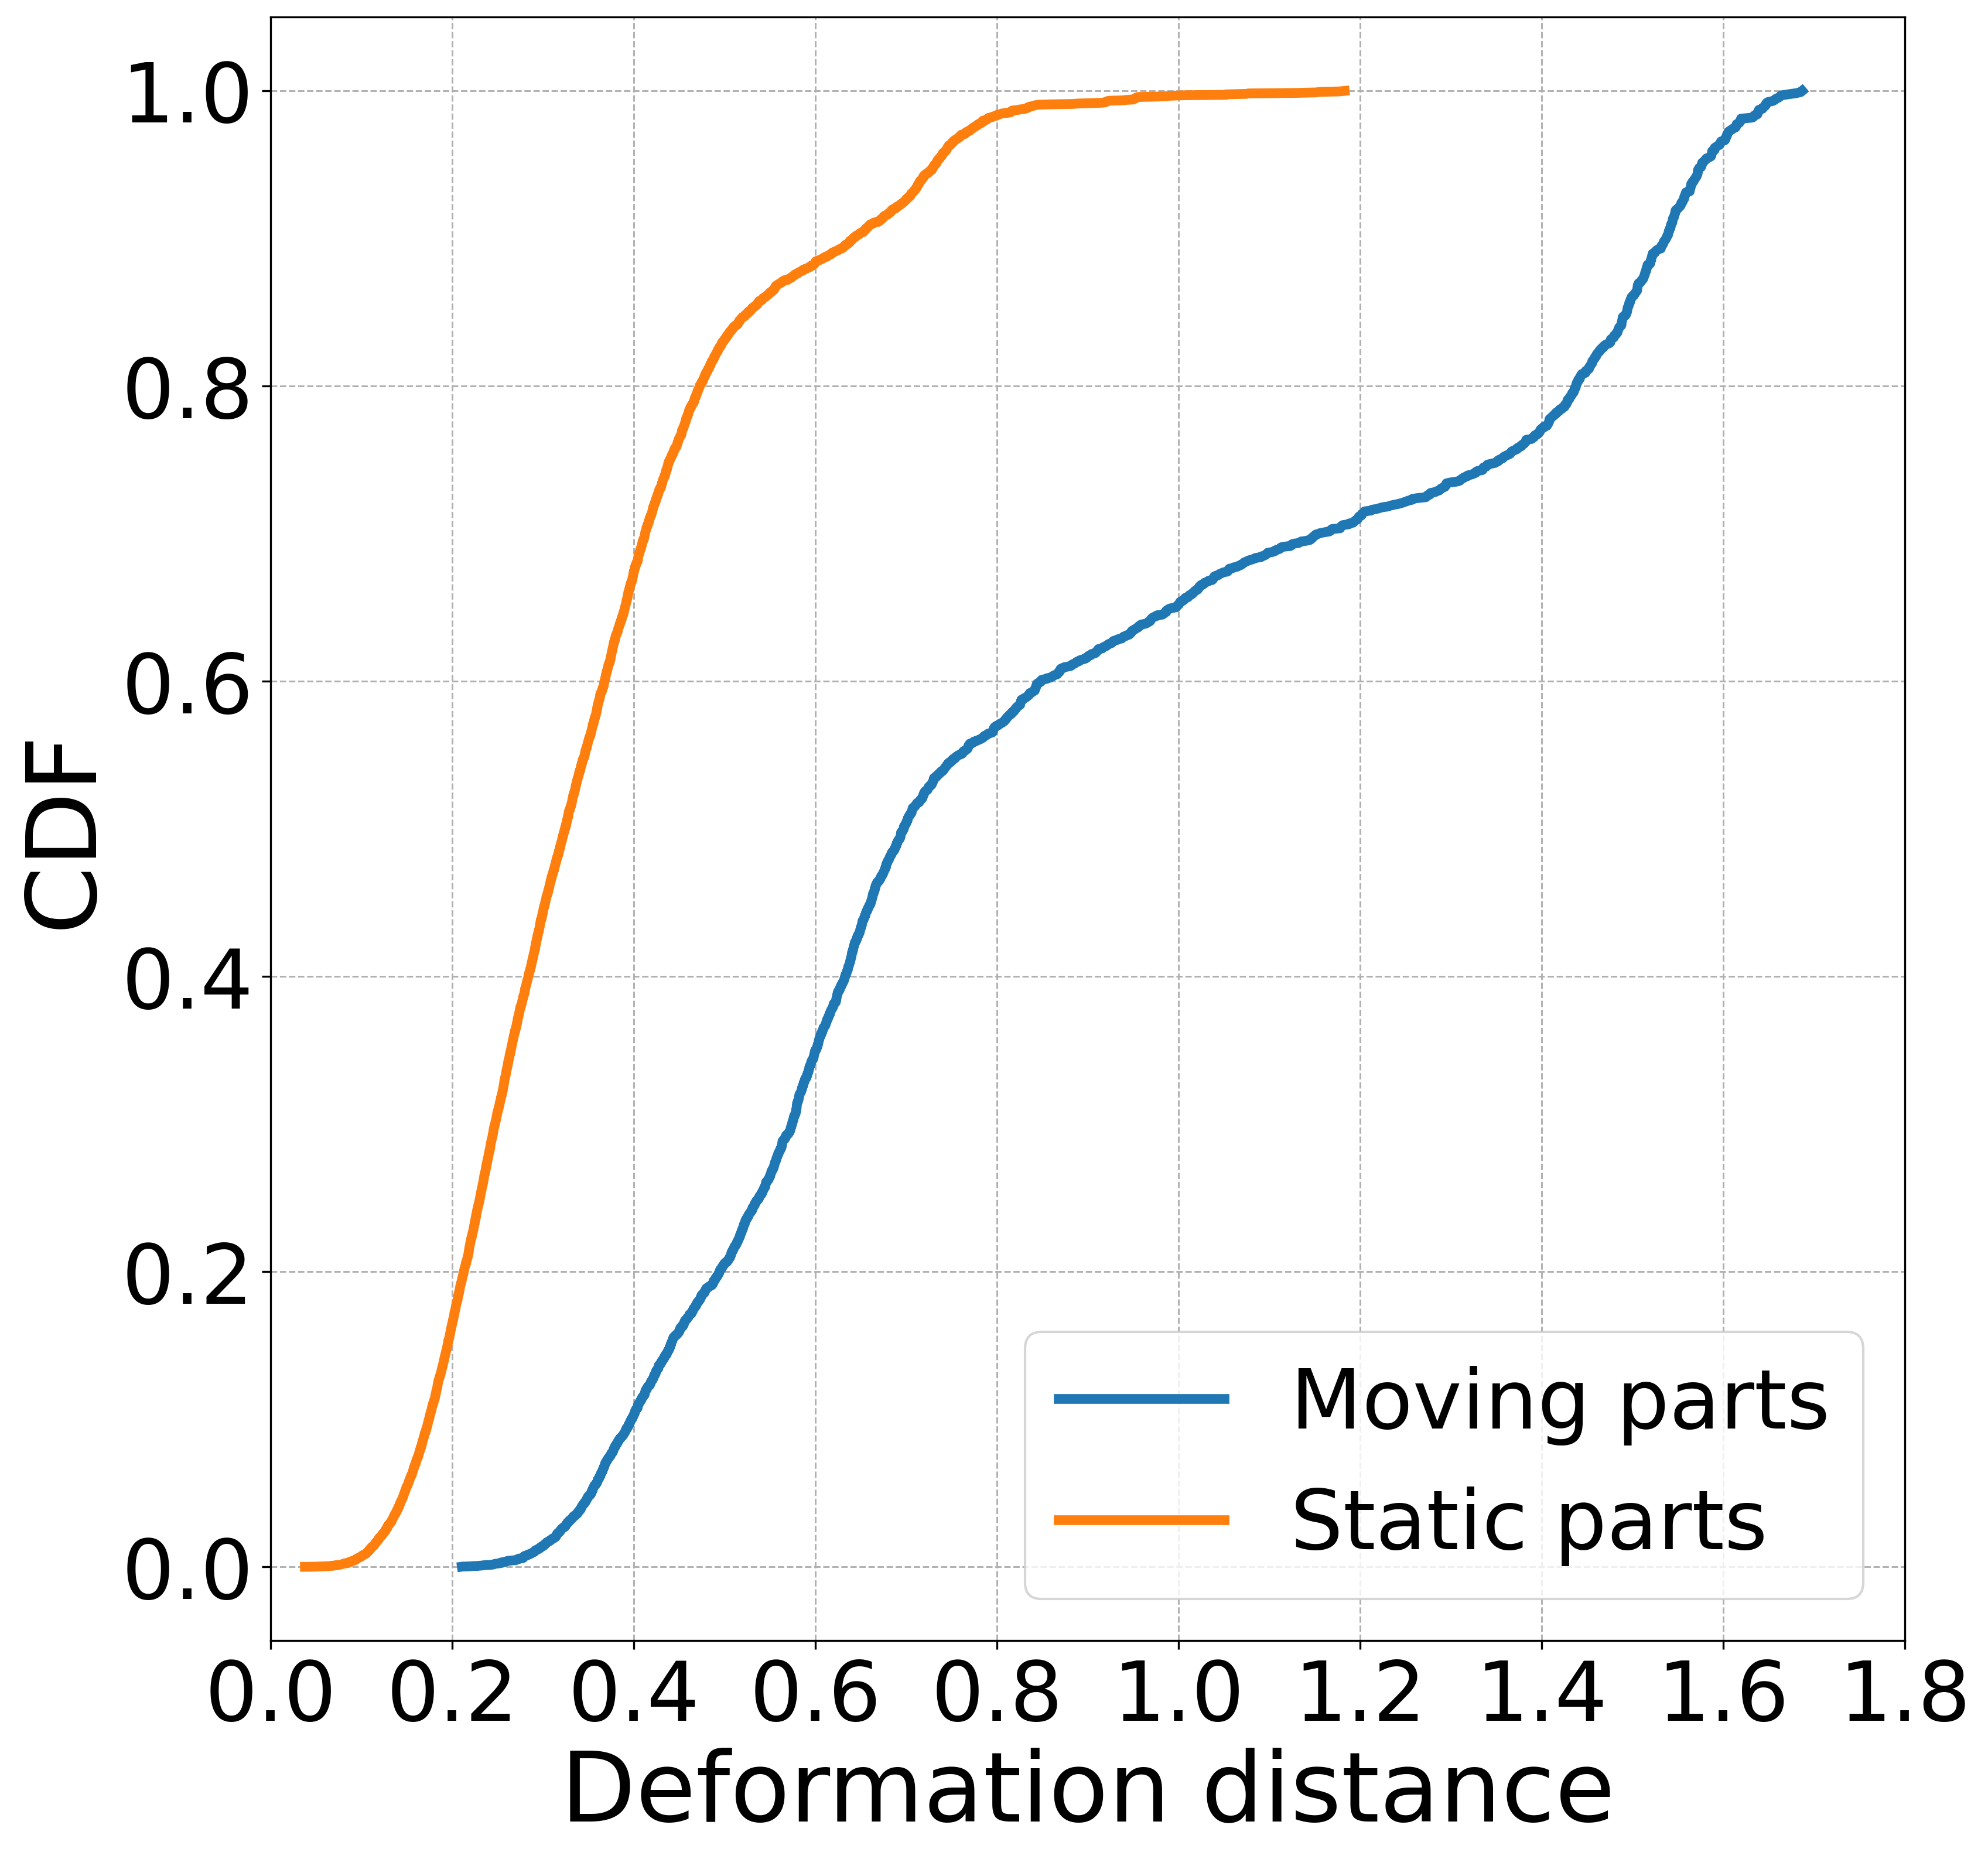
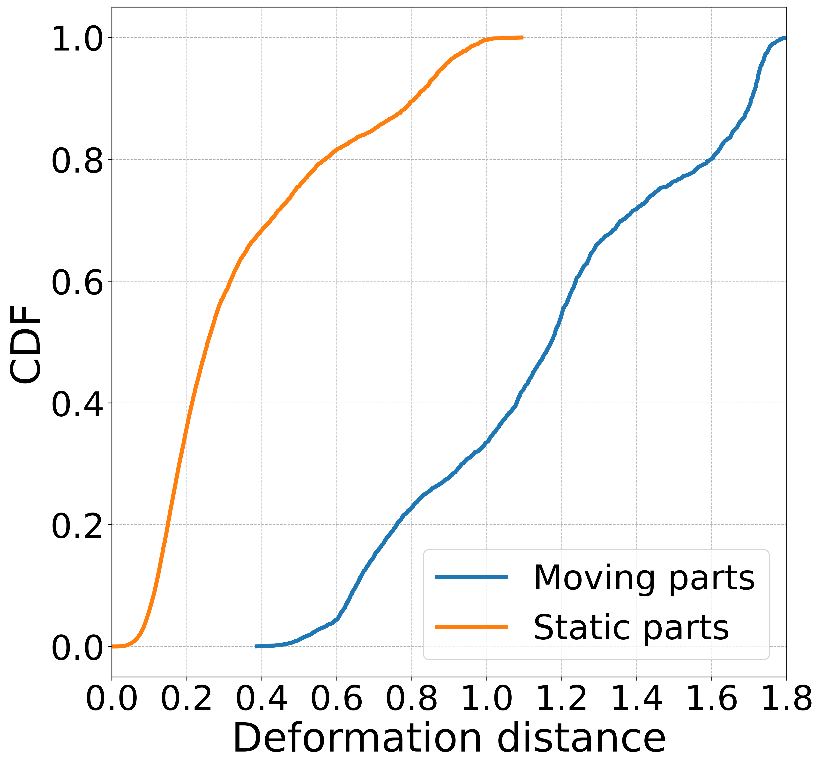
We re-ran the original TVMC code and successfully reproduced key quantitative results from the paper. The plots above — including deformation distance CDFs (Basketball, Thomas) and D2-PSNR vs. bitrate curves (Dancer) — closely match the published figures, validating the implementation and demonstrating the reproducibility of the authors’ claims.
Rate-distortion (RD) performance on the Dancer sequence across different Group-of-Frames (GoF) sizes. Larger GoFs (e.g., 15) maintain similar or better D2-PSNR at lower bitrates, showing improved compression efficiency.
Cumulative distribution of deformation distances for static and moving parts for basketball player mesh sequence. TVMC yields significantly lower deformation in static regions while accommodating flexibility in dynamic areas, highlighting the effectiveness of center-affinity deformation.
CDF plot of deformation distances for static vs. moving regions in the "Thomas" sequence. TVMC maintains low deformation for static parts, demonstrating stability, while accommodating broader variations in dynamic segments.

Slide 10
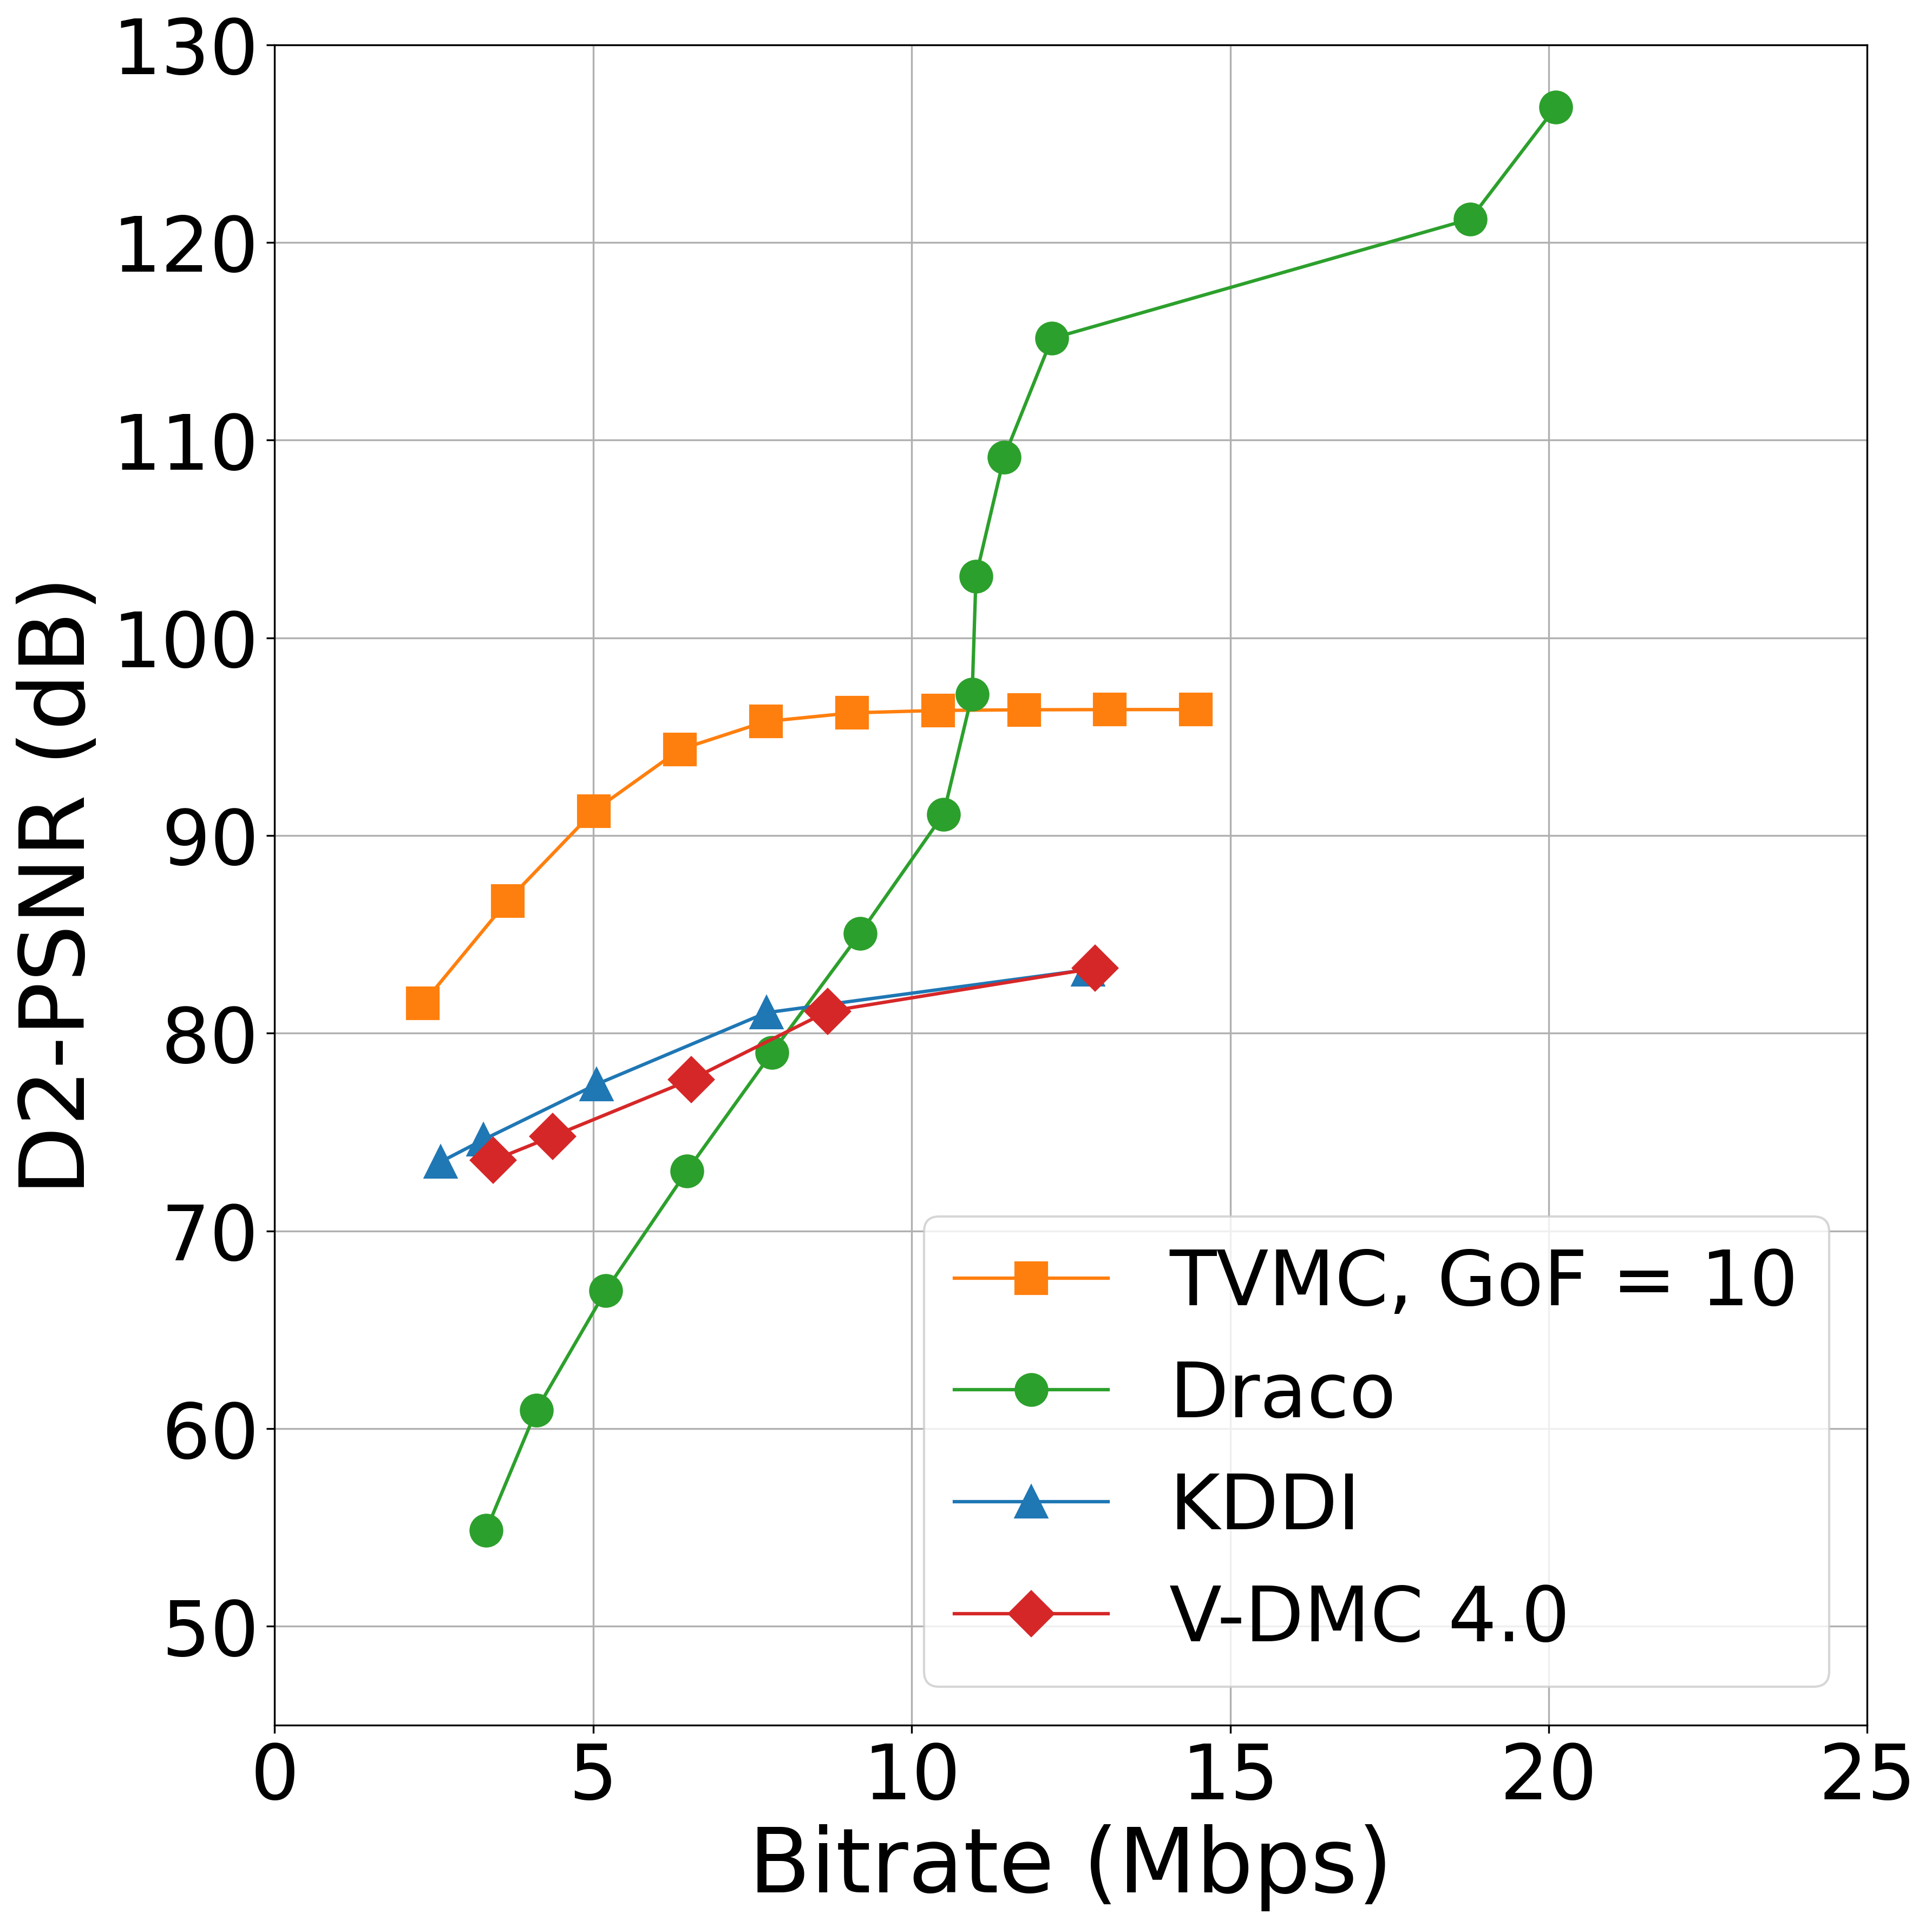
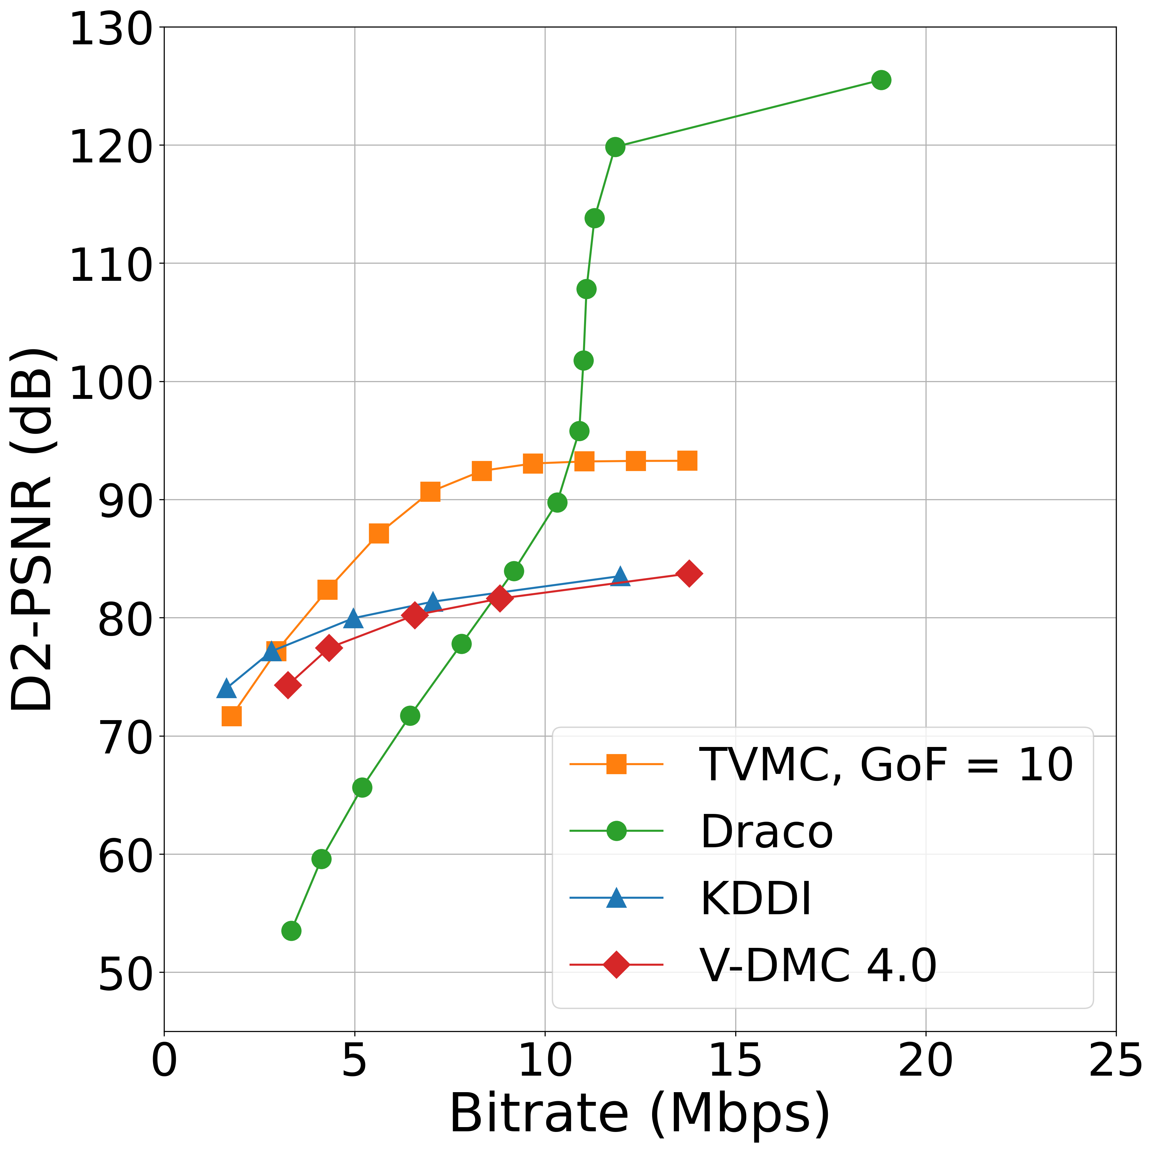
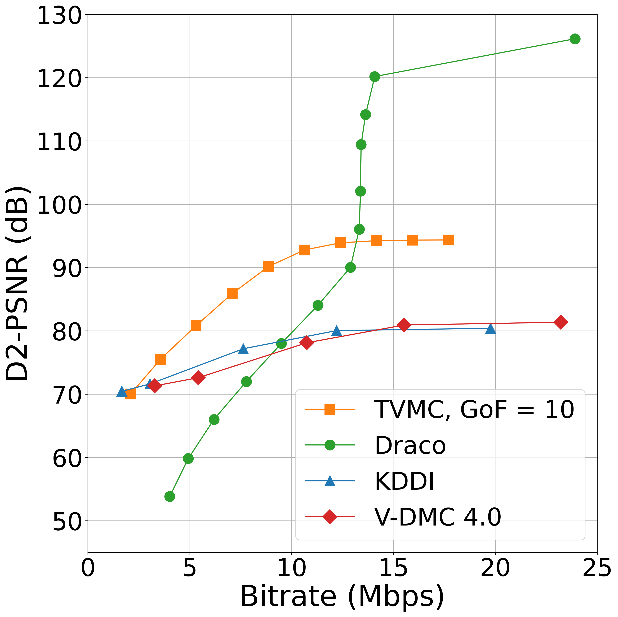
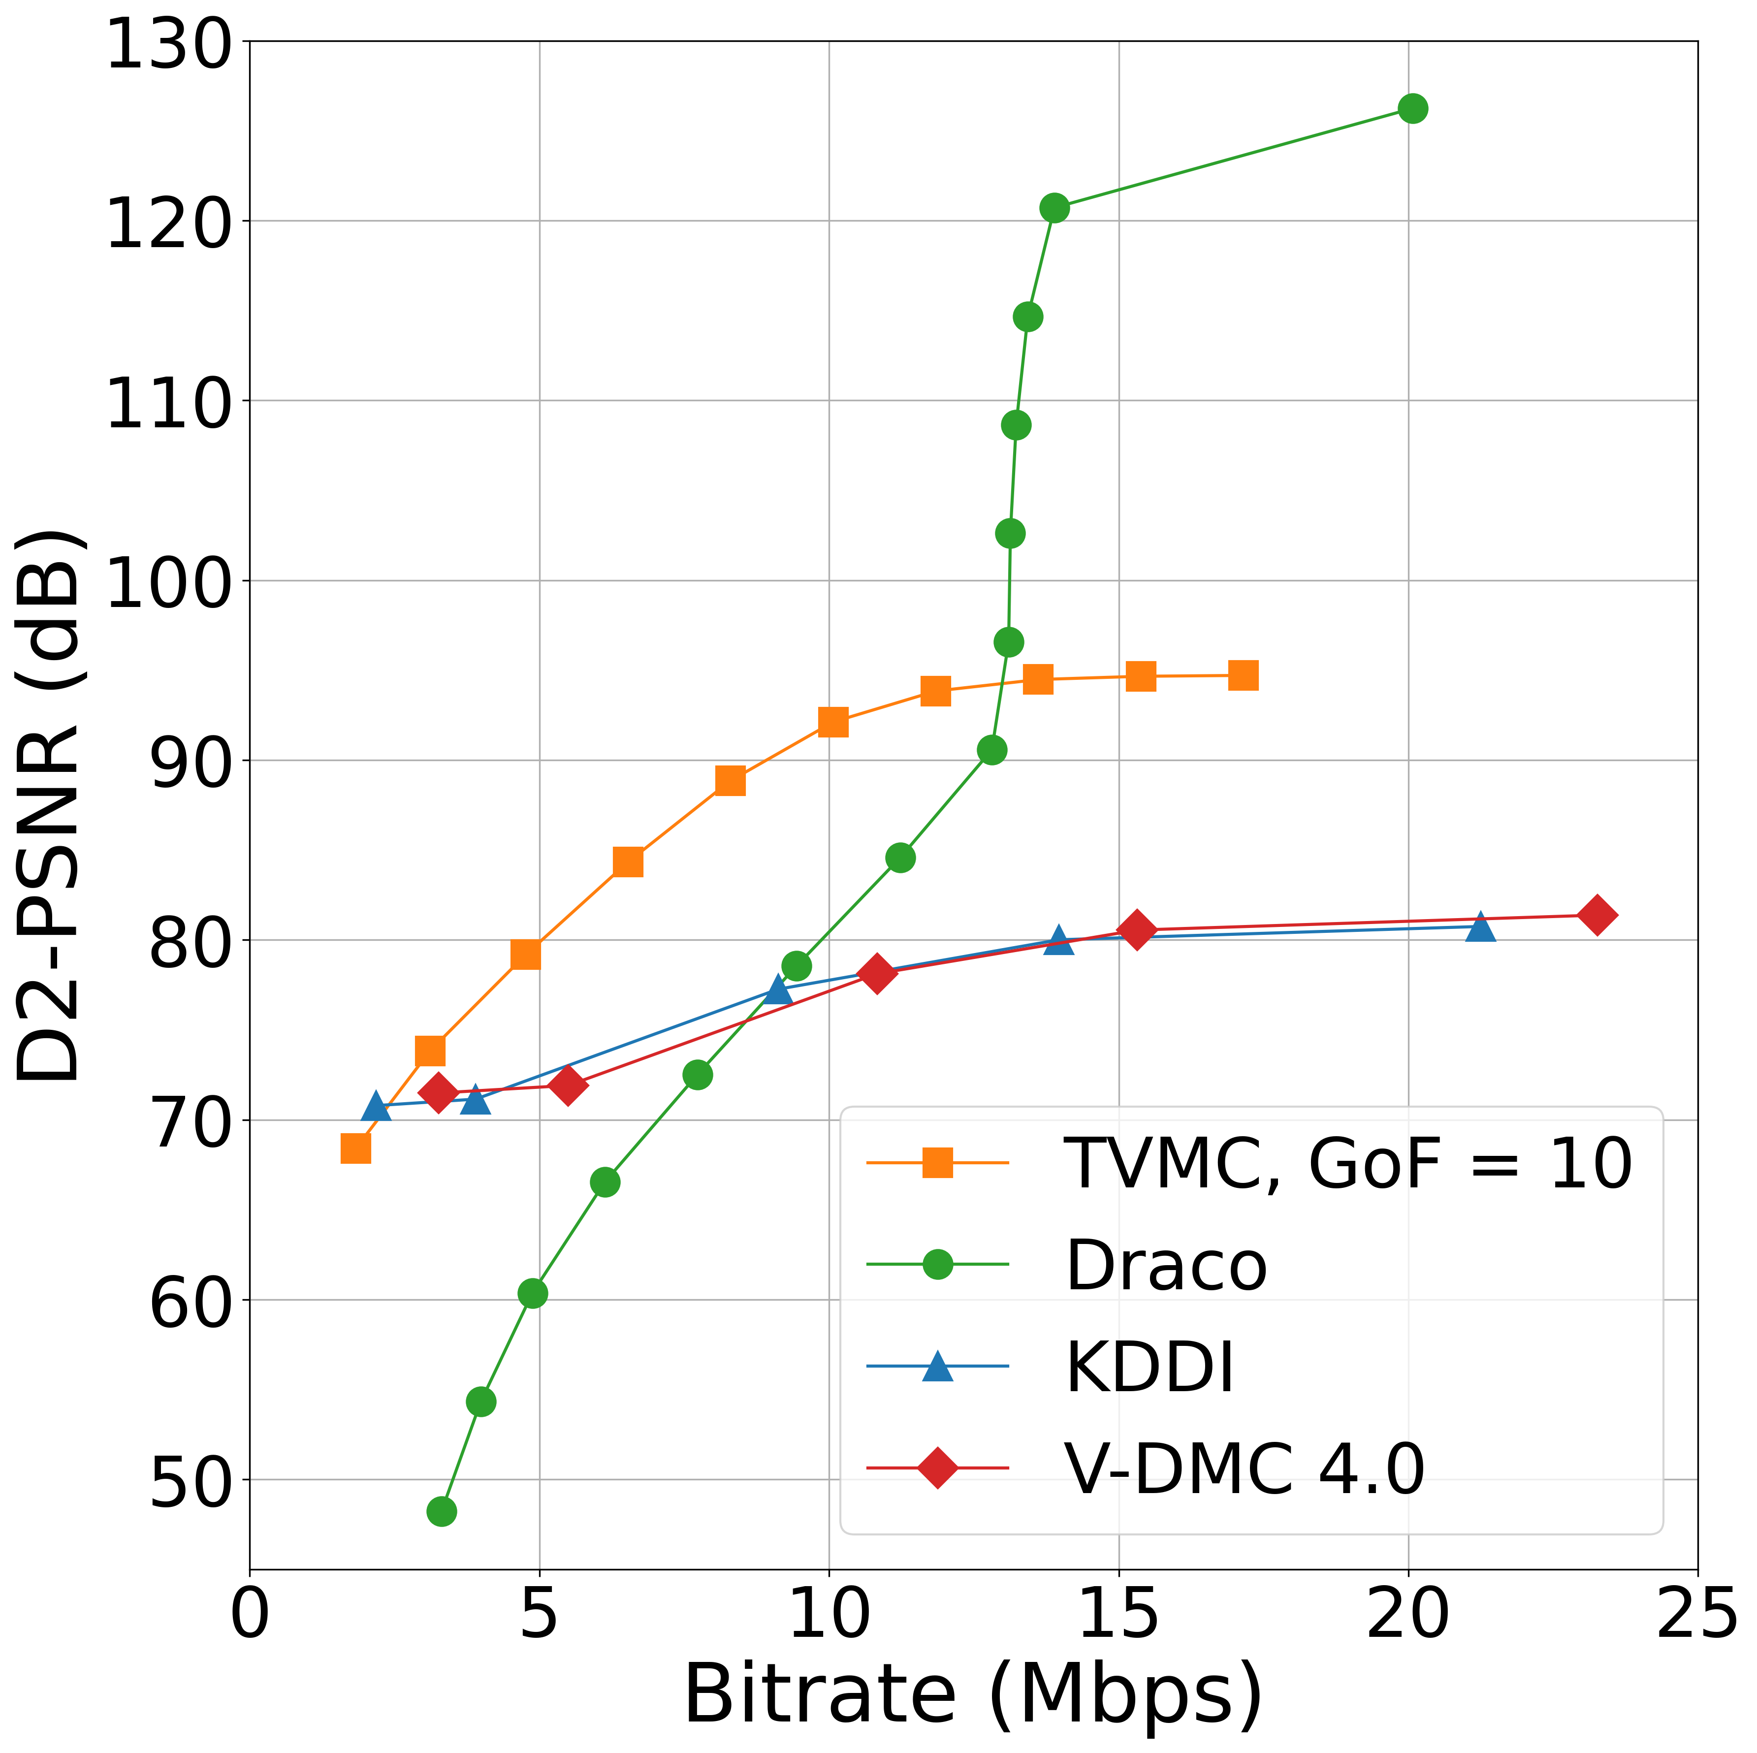
Rate-Distortion Performance Across Sequences From left to right: Basketball, Mitch, Dancer, Thomas. Each subplot compares the D2-PSNR versus bitrate for four mesh compression methods — TVMC (GoF = 10), Google Draco, KDDI, and V-DMC 4.0. We re-ran the TVMC pipeline on the released datasets and reproduced these results nearly identically, confirming the claims made in the original paper (Chen et al., MMSys 2025).TVMC consistently achieves better visual quality at lower bitrates compared to prior baselines, validating the effectiveness of volume-tracked reference mesh compression.
Basketball_Player
Mitch
Dancer
Thomas

Slide 11
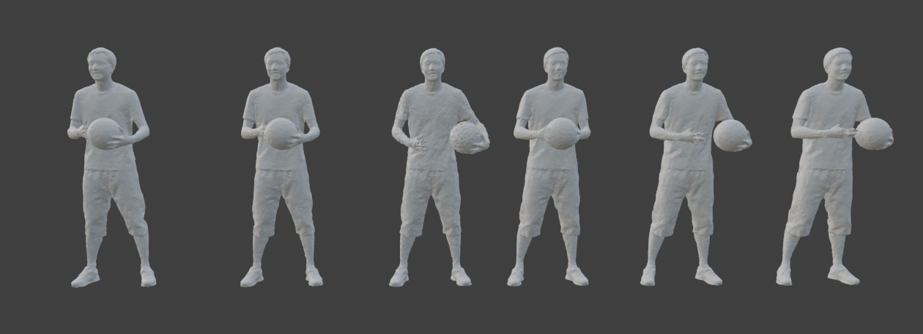
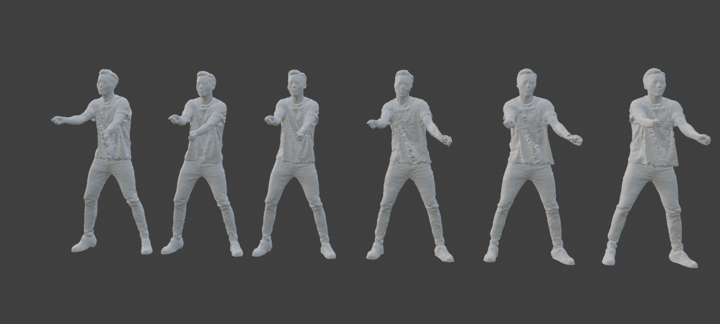
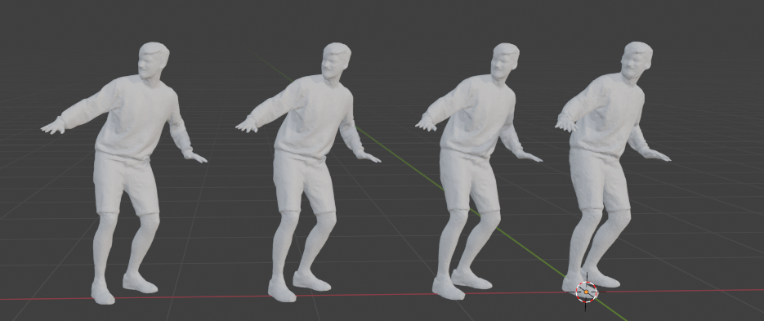
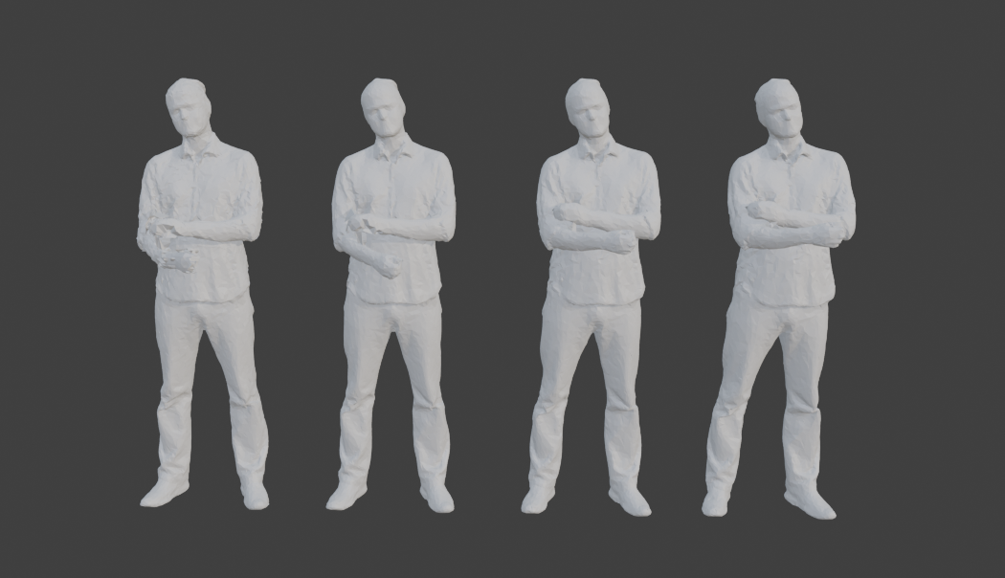
Although the official GitHub repository primarily highlights the basketball player dataset in its README and example scripts, we were able to successfully run the full TVMC pipeline on the Mitch, Dancer, and Thomas sequences as well. The provided Docker image included all dependencies and scripts, making the setup process relatively seamless. Once the input mesh sequences were placed in the expected directory structure, the pipeline executed without significant modifications. This ease of extensibility reinforces the reproducibility and generalizability of the TVMC framework across different types of time-varying mesh data.
Basketball Player
Dancer
Mitch
Thomas
Final reconstructed mesh sequences from the TVMC pipeline, visualized in Blender. Each row shows the decoded .obj files for a different dataset: Basketball Player, Dancer, Mitch, and Thomas. These visual results confirm successful end-to-end processing across all sequences.

Slide 12
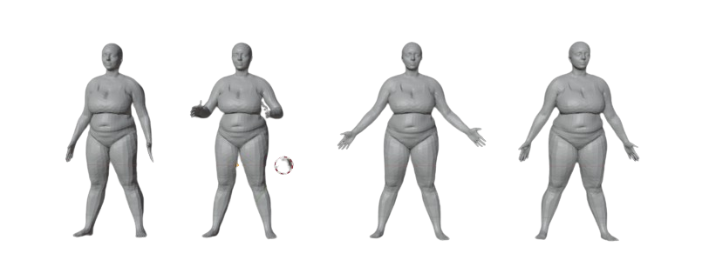
Testing Using DFAUST Dataset
We evaluated our compression and reconstruction pipeline on the DFAUST dataset from the Max Planck Institute, which provides high-quality dynamic 3D scans of human subjects in motion, with per-frame ground-truth registrations. The dataset contains both male and female sequences; we used data from the female subset, specifically the "chicken wings" and "shake arms" sequences. Each sequence consists of 240 frames, capturing subtle to large-scale non-rigid body deformations. Following the protocol used in the TVMC paper, we focused on frames 11 to 20, a short segment where only limited movement is visible. This setting provides a controlled evaluation scenario to measure compression performance and reconstruction fidelity on near-rigid temporal windows.
Comparison of dynamic 3D human mesh frames from the D-FAUST dataset (chicken wings frames 11 & 20 on the left, shake arms frames 15 & 20 on the right). Each sequence contains 240 frames, but we use only frames 11–20 as in the original protocol, resulting in subtle motion differences. (Source: Bogo et al., "Dynamic FAUST: Registering Human Bodies in Motion", CVPR 2017)

Slide 13
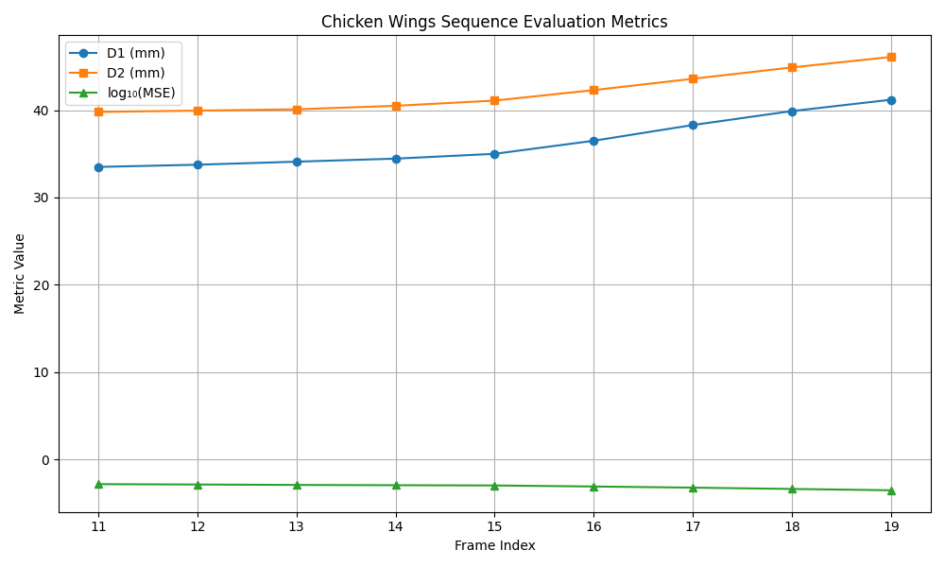
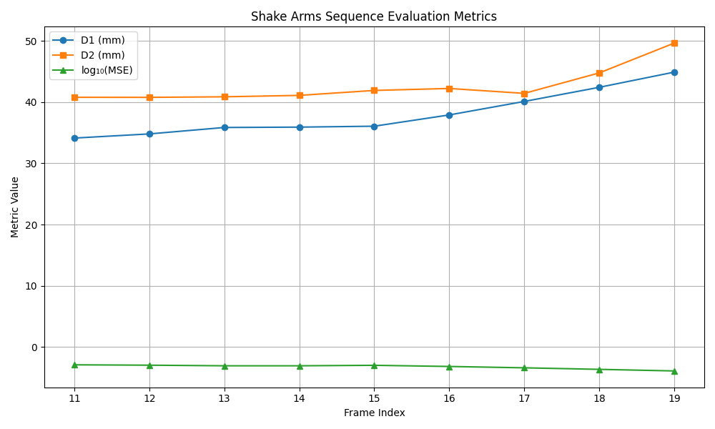
Figure: Evaluation Metrics for DFAUST Sequences – "Chicken Wings" vs "Shake Arms" Quantitative evaluation of TVMC compression quality over frames 11 to 19 for two DFAUST sequences: chicken wings and shake arms. Metrics include point-to-point (D1) and point-to-surface (D2) distances in millimeters, and log₁₀ of mean squared error (MSE). As expected, both sequences show a gradual increase in reconstruction error as the frame index increases. The shake arms sequence exhibits sharper metric changes, suggesting more significant non-rigid motion compared to chicken wings, which remains relatively stable.

Slide 14
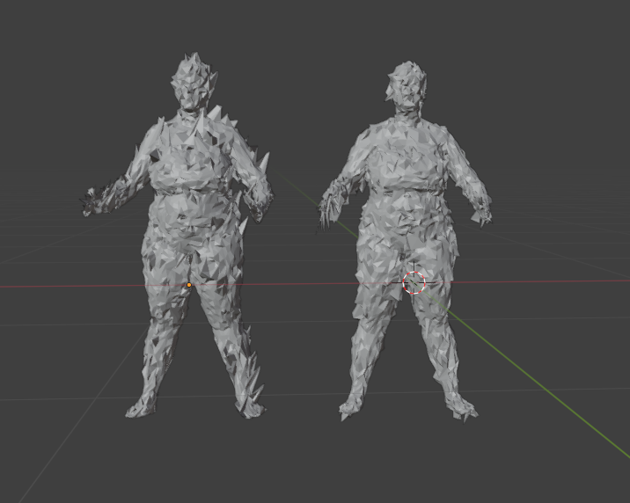
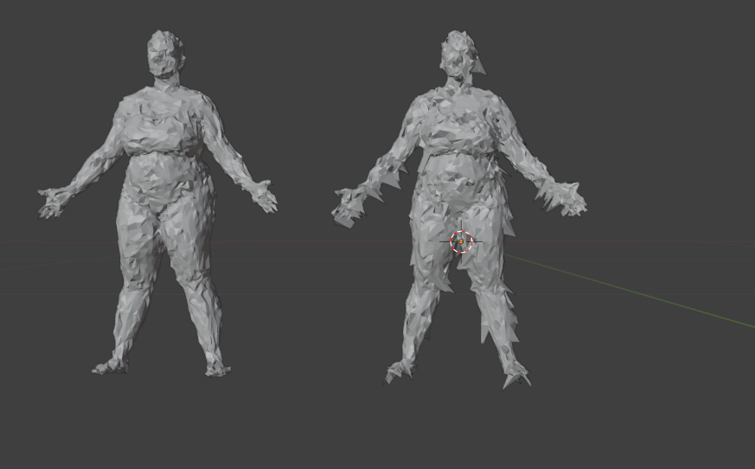
Shaking Arms (Frame 15 & 20) – Pipeline Without Fixes
Meshes reconstructed using the original TVMC pipeline without center alignment or transformation corrections show severe geometric instability and surface artifacts. Notice the spiking and noisy deformations across frames.
Chicken Wings (Frame 15 & 20) – Pipeline Without Fixes
Without pipeline improvements, the chicken wings dataset produces distorted reconstructions with visible surface tearing and pose inconsistencies between frames.

Slide 15
DFAUST Reconstruction Failures and Correction Strategies
Original Issues in the DFAUST Pipeline (50004_shake_arms and 50004_chicken_wings)
The output meshes for frames 15 and 20 showed severe spikiness and distortion, particularly in limbs and facial regions.
This was caused by directly applying nearest-neighbor displacements to subdivided mesh vertices without filtering or alignment.
The displacement vectors were often too large or misaligned, leading to unnatural deformations.
Open3D failed to compute vertex normals in some frames due to inconsistent geometry after applying raw displacements.
No smoothing or validation steps were applied, so even minor displacement noise translated into visible artifacts.
The pipeline relied only on one-way KD-tree matching, which caused incorrect correspondences in regions with fast motion or complex geometry.
Fixes Applied to DFAUST (50004_shake_arms and 50004_chicken_wings)
Displacement vector magnitudes were clamped (e.g., to 0.02 units) before being applied to the mesh. This prevented large, erroneous spikes.
Laplacian smoothing (3 iterations) was applied to the reconstructed mesh before computing normals. This helped suppress sharp distortions.
Fallbacks for Open3D normal computation were added to handle frames where default normal estimation failed.
Displacement norms were visualized and logged, allowing us to detect and avoid outliers that corrupted the mesh.
Bidirectional nearest-neighbor averaging was introduced, combining forward and backward correspondences to reduce noise.
Confidence-weighted updates were added, using the distance between matched points to scale down unreliable displacements.

Slide 16
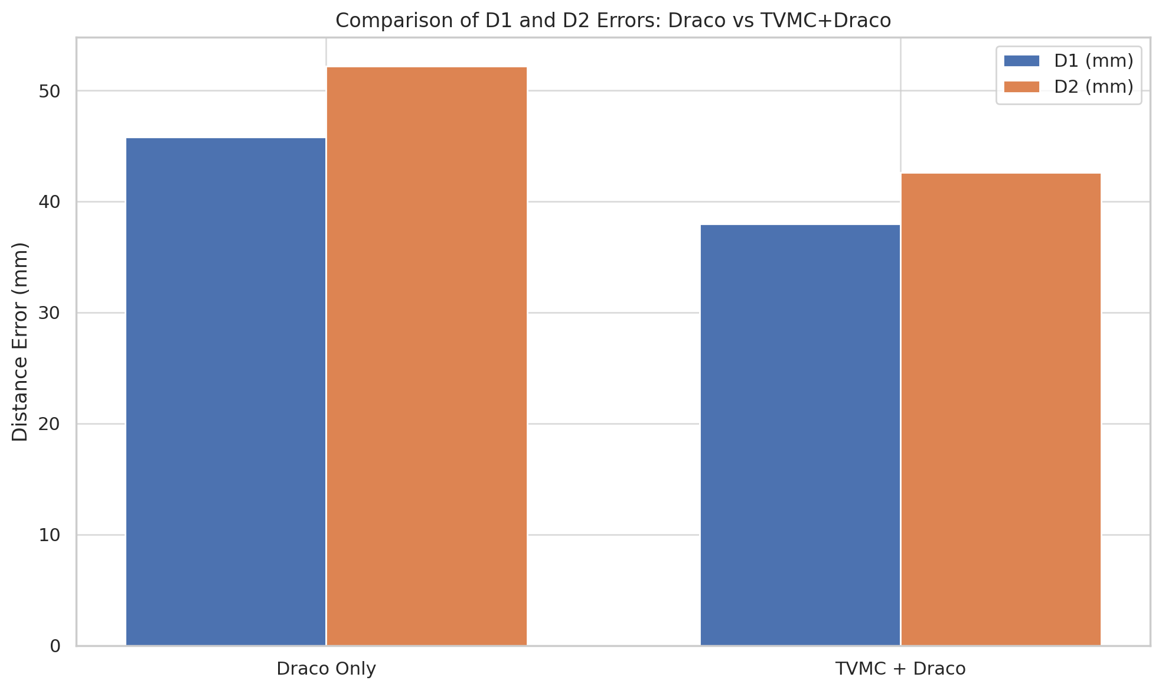
Comparison of Compression Strategies: Draco vs TVMC+Draco
To evaluate the effectiveness of TVMC’s mesh compression pipeline, we conducted a direct comparison between standalone Draco compression and the full TVMC+Draco method. Using a custom Python script, we automated the compression and metric collection process across multiple frames from the 50004_shake_arms sequence. Metrics such as D1/D2 distance errors, log10 MSE, PSNR, bitrate, and decode time were extracted. Results indicate that TVMC+Draco achieves significantly lower geometric distortion (D1: 38 mm vs 45.8 mm, D2: 42.6 mm vs 52.2 mm) and better reconstruction fidelity (PSNR: 35.1 dB vs 31.6 dB). While TVMC+Draco incurs a slightly higher bitrate and marginally slower decode time, the substantial quality improvements justify the additional cost. This analysis highlights the value of incorporating temporally-aware deformation and compression in dynamic mesh pipelines.
Method | D1 (mm) | D2 (mm) | log10 MSE | PSNR (dB) | Bitrate (Mbps) | Decode Time (ms)
Draco Only | 45.8 | 52.2 | -2.68 | 31.6 | 0.23 | 5.8
TVMC + Draco | 38 | 42.6 | -3.23 | 35.1 | 1.6 | 6.3
Quantitative comparison of compression results. TVMC+Draco outperforms Draco-only in fidelity metrics (D1, D2, PSNR), at the cost of slightly higher bitrate and decode time.
Bar chart comparing D1 and D2 geometric errors between Draco-only compression and the combined TVMC+Draco pipeline. TVMC+Draco achieves significantly lower error, indicating more accurate mesh reconstruction.

Slide 17
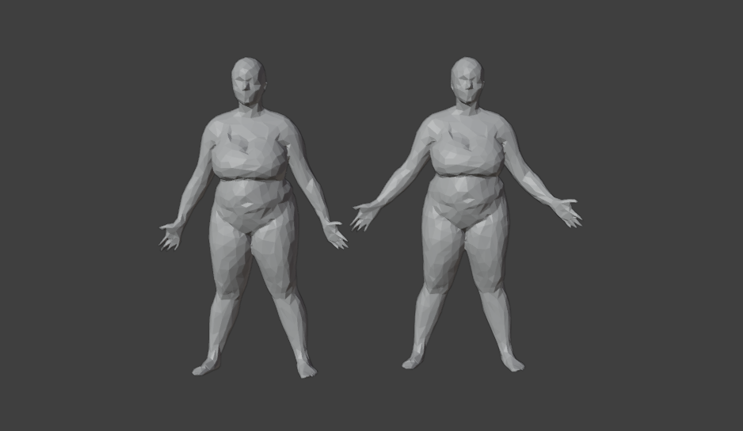
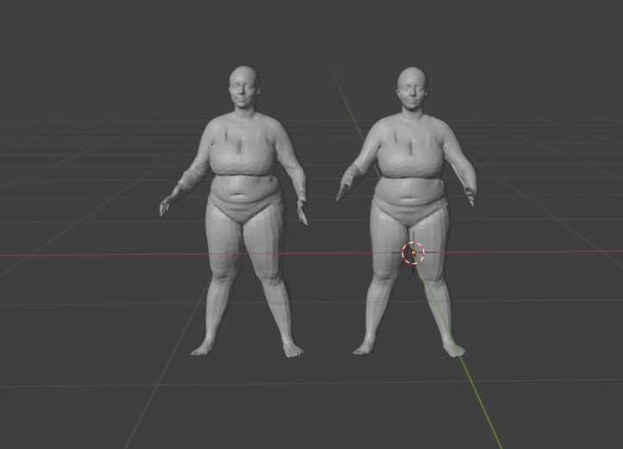
Shaking Arms (Frame 15 & 20) – Pipeline With Fixes
Applying improved center extraction, accurate transformation computation, and corrected reference alignment results in clean, temporally stable meshes. The spiking artifacts are eliminated, and the geometry is consistently preserved.
Chicken Wings (Frame 15 & 20) – Pipeline With Fixes
With the corrected pipeline, mesh outputs are smooth, well-aligned, and temporally consistent, enabling accurate compression and higher-quality deformation tracking.

Slide 18
Critical Analysis and Proposed Enhancements
Strengths
Self-contact Handling: Operates on volume centers instead of surfaces, reducing artifacts in self-occluding regions.
Volume-Based Deformation: Tracks internal motion using ARAP centers, improving robustness over surface-only methods.
Compression Modularity: Displacements and reference meshes are encoded separately, allowing plug-and-play codecs.
Self-Contact Degree: Uses affinity-based heuristics to identify problematic frames — simple, interpretable, and effective.
Weaknesses
Hard-Coded Frame Dropping: Drops half the frames in each group using a fixed threshold, which may discard valuable motion.
No End-to-End Learning: The pipeline is fully hand-crafted, lacking adaptability or data-driven optimization.
Poisson Reconstruction Limitations: Assumes watertight input; can fail or produce noisy surfaces for partial scans.
Euclidean-Based Blending: Neighbor selection in deformation ignores mesh topology, risking incorrect influence.
Independent Frame Compression: Draco compresses each displacement separately, ignoring temporal correlation.
Displacement Instability: Nearest-neighbor-based reconstruction can introduce local artifacts under fast motion, self-intersections, or inconsistent mesh topology — limiting generalization across DFAUST sequences i.e external datasets which were not provided by the paper.

Slide 19

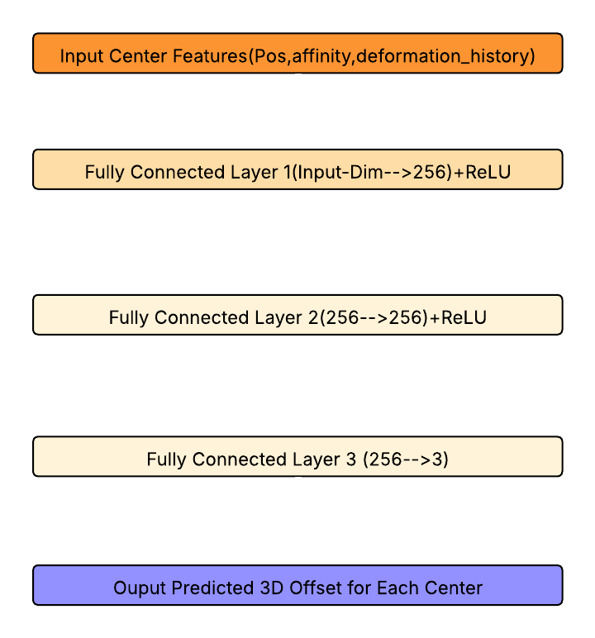
Suggested Improvements
1. Soft Frame Fusion (instead of hard discarding) Use weighted averages of all frames in a group, where each frame’s influence is based on its self-contact confidence. This avoids losing valuable data due to fixed thresholds.
2. Lightweight Learned Deformation Predictor Replace hand-tuned deformation steps with a small neural network that learns to predict how each volume center should move, improving adaptability and robustness.
3. Implicit Surface Fitting (Instead of Poisson) Poisson reconstruction may fail on non-watertight or noisy meshes. Implicit surface models, such as occupancy networks or signed distance functions, can offer smoother and more reliable surfaces. Reference: Sang, L., Canfes, Z., Cao, D., Bernard, F., & Cremers, D. (2025). Implicit Neural Surface Deformation with Explicit Velocity Fields. arXiv preprint arXiv:2501.14038
4. Geodesic Blending via Mesh Graph Current blending uses Euclidean distances which ignore mesh structure. Using mesh graphs and geodesic distances ensures better topology-aware deformation.
5. Temporal Delta Encoding for Displacements Instead of storing absolute displacements for every frame, compress only the differences between consecutive frames. This reduces redundancy and improves compression ratios.
6. Diversity-Based Frame Selection via KL-Divergence Rather than picking frames based on simple heuristics, use KL-divergence to select frames that are most distinct from each other, ensuring higher representational diversity within a group.
Weighted influence of frames based on self-contact confidence for adaptive averaging.
Example Neural Network for Deformation Predictor

Slide 20
Conclusion
This project successfully reproduced and extended the TVMC (Time-Varying Mesh Compression) pipeline on both the official datasets and external DFAUST sequences, validating many of the original claims. Our investigation highlighted the pipeline’s strengths in handling self-contact and modular compression, while also exposing its fragility in high-deformation or topology-inconsistent scenarios like those in DFAUST.
Through targeted modifications — such as displacement clamping, bidirectional correspondence averaging, and Laplacian smoothing — we improved reconstruction quality significantly on challenging sequences. However, these fixes remain dataset-specific and lack generalizability.
Future work should explore end-to-end learnable deformation models, topology-aware blending, and temporal-aware compression to enhance robustness and scalability. By integrating these advances, we can move closer to real-time, high-fidelity mesh streaming for dynamic human avatars in AR/VR systems.

Slide 21
Thank you!

